Slide 1


Geometric Analysis Based Algorithms for Effective Representation and Detection of Curves with Application to Tracking Moving Dim Target
Advisor: Dr. Ofer Levi
By: Galit Volpert

Slide 2
Presentation Outline
Motivation
Objectives
Background
SHAS vs other X-ray approaches
Dynamic SHAS
Dim Target tracking application
Experiments methodology
Results

Slide 3
Motivation
Multiscale Geometric Analysis
Detect, organize, represent, and manipulate
data
which nominally span a high-dimensional space
but
which contain important features
which are approximately concentrated on lower-dimensional subsets (curves, sheets, etc.).
http://www.ipam.ucla.edu/programs/long-programs/multiscale-geometry-and-analysis-in-high-dimensions/
Notes:
Works done in the scientific area that deals with…..

Slide 4
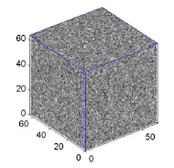
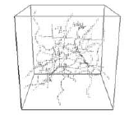
Motivation
Data of Interest
n³ – voxels (cube), f(x,y,z)
-point field
Contains filaments and noise
Notes:
אלמנטים חוטים

Slide 5
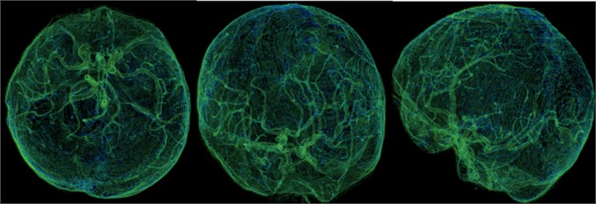
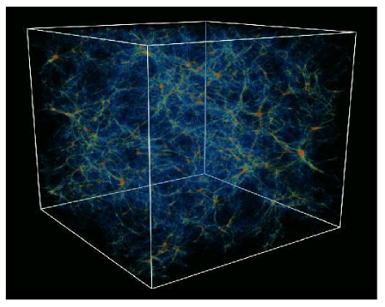

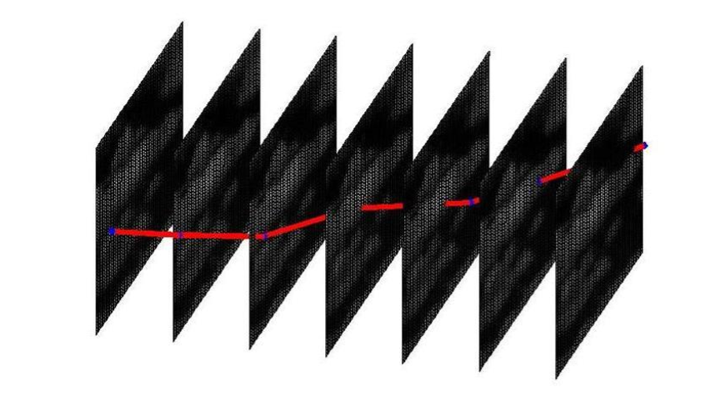
Motivation
Applications
Medical and Biological Imaging
Astronomy
Dim Moving Objects Tracking
Mehul P. Sampat, Alan C., Bovik B., Mia K. Markey, Classification of mammographic lesions into BI-RADS shape categories using the Beamlet Transform
https://www.jvejournals.com/article/20724
D. L. Donoho a, O. Levi a, J.-L. Starck b and V.J.Mart´ınez c ,Multiscale Geometric Analysis for 3-D Catalogues
https://www.pinterest.com/pin/490540584389823063/

Slide 6
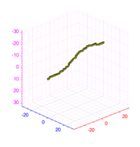
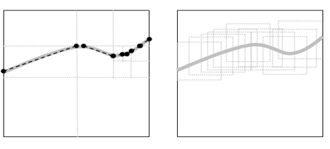
Motivation
Dim Moving Objects Tracking
Man-made dim moving target.
A point target.
Low SNR (barely seen by naked eye).
Multiscale
Dynamic - Mono-scale
?
Notes:
Our interest is in the detection of a sub-pixel target, which is significantly smaller than pixel size, where there is no need to take into account the target point spread function, which is assumed to have its entire support inside a single pixel.
Multiscale based algorithm – develop by Boris Efrati in its thesis
Dynamic Mono-scale based algorithm – this thesis

Slide 7
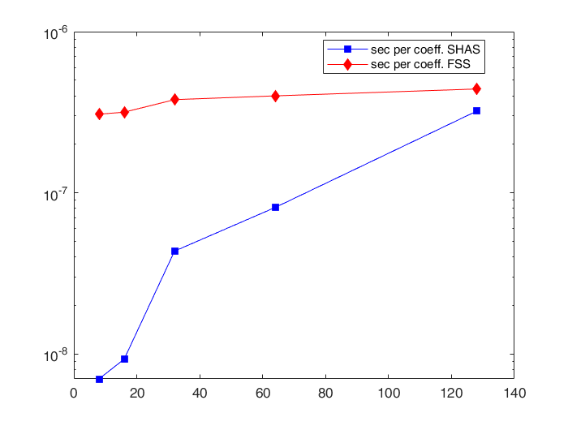
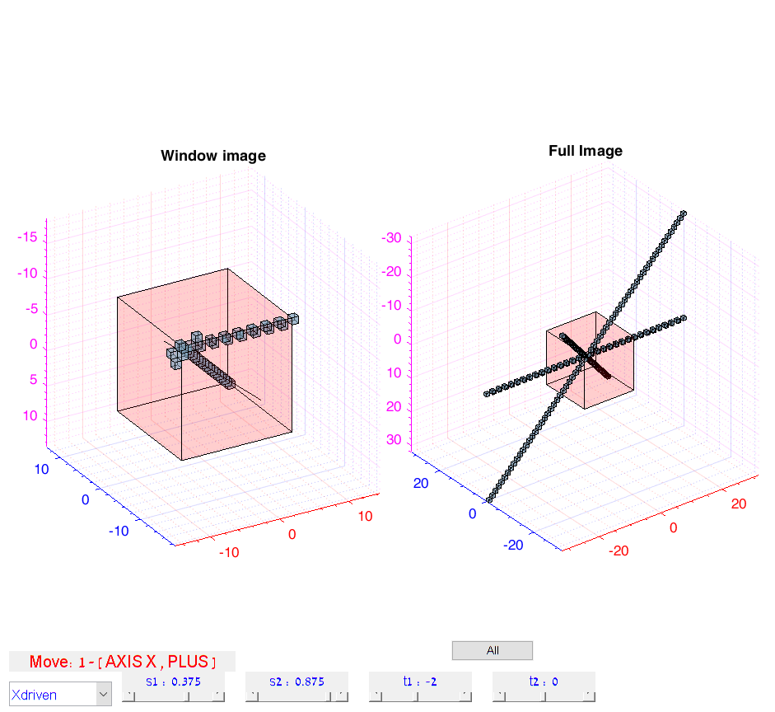
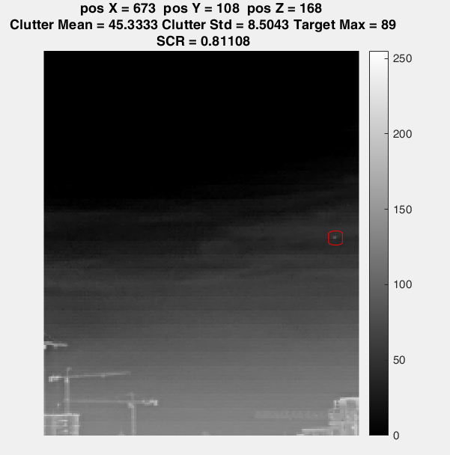
Objective
Validate the accuracy and efficiency of the Geometric approach X-ray transform algorithm named SHAS by comparing to other discrete X-Ray transform algorithms such as Fast Slant Stack and Two-Scale Recursion.
Analyze and present the Dynamic SHAS as a computationally efficient algorithm for dynamically computing X-Ray coefficients inside a sliding window.
Develop a Dynamic SHAS based tool for tracking a dim target.

Slide 8
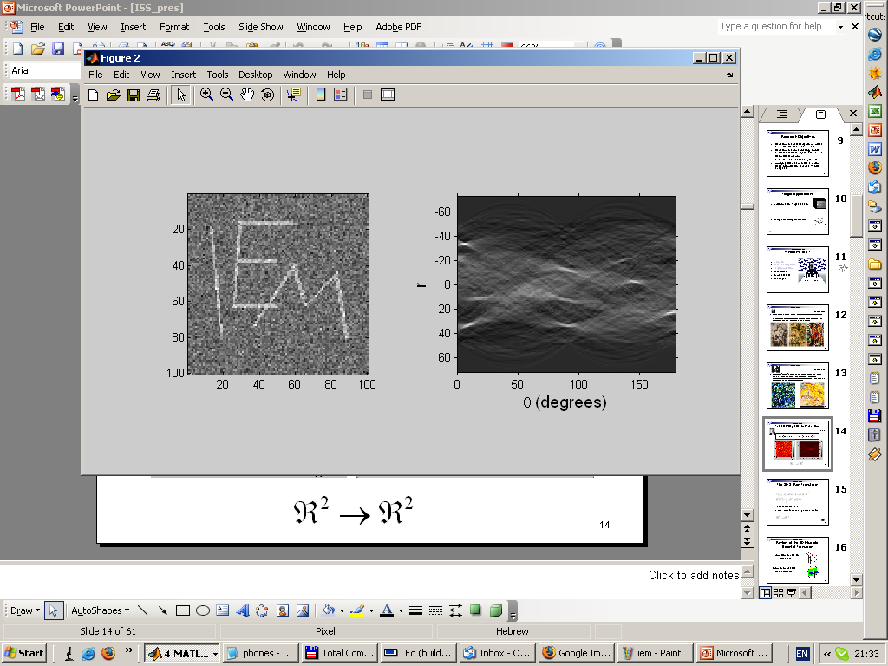
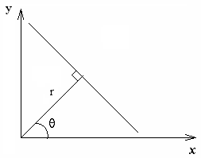
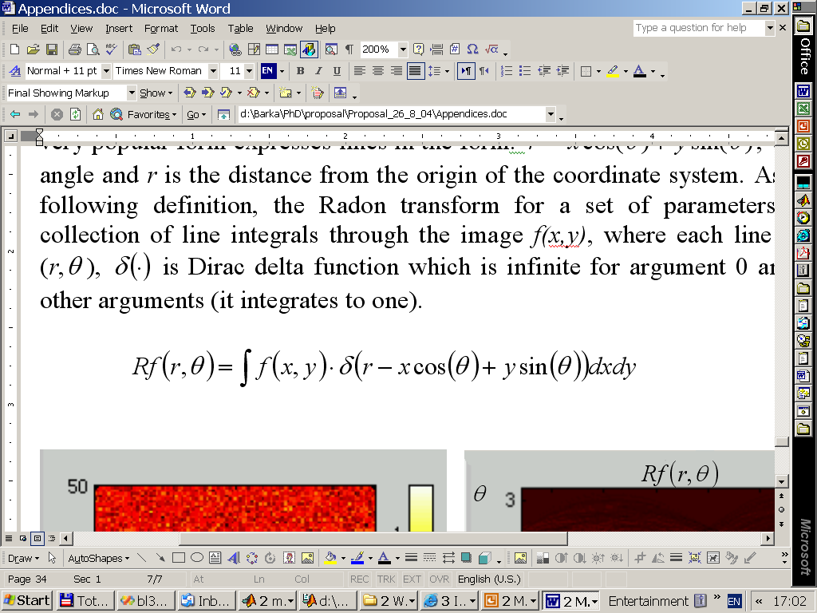
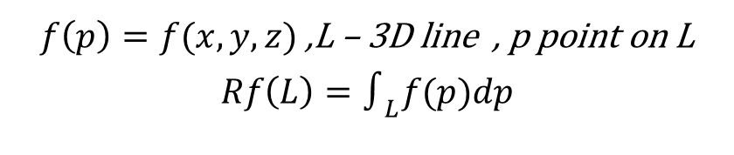
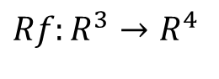
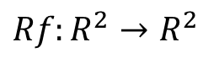
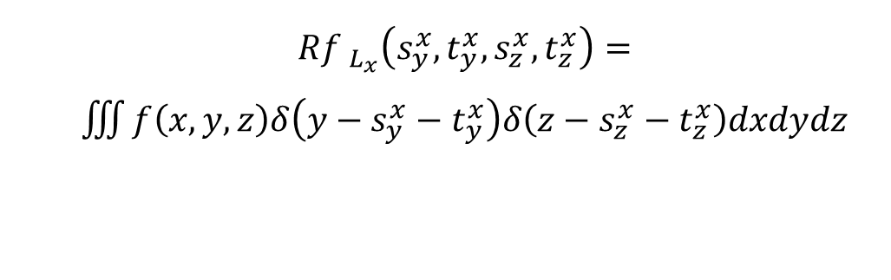
Background
X-Ray Transform
An integral transform mapping spatial data into the parametric space of line integrals
2D 3D
$f\left(p\right)=f(x,y,z)$ ,L – 3D line , p point on L
$$Rf\left(L\right)=∫_{L}f(p)dp$$
$${Rf }_{L_{x}}\left(s_{y}^{x},t_{y}^{x},s_{z}^{x},t_{z}^{x}\right)=$$
$\iiint{f\left(x,y,z\right)δ\left(y−s_{y}^{x}−t_{y}^{x}\right)δ\left(z−s_{z}^{x}−t_{z}^{x}\right)dxdydz}$
$${Rf:R}^{2}→R^{2}$$
$${Rf:R}^{3}→R^{4}$$
Notes:
$\text{point} \text{and} \text{unit} \text{vector} R^{6}→R^{4}$

Slide 9
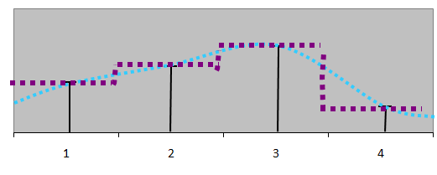
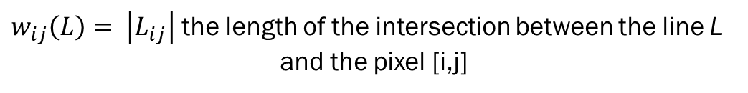
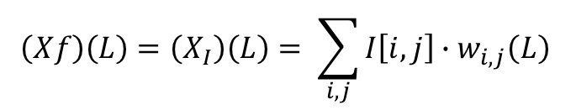
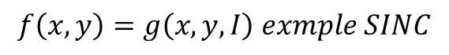
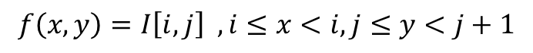
Background
Discrete X-ray transform
Interpolation Scheme
0
9
1
9
10
5
3
10
6
8
10
3
9
3
8
4
Piecewise constant interpolation – interpolation of order zero
“smooth” interpolation – interpolation of higher orders
$$f\left(x,y\right)=I\left[i,j\right] ,i≤x<i,j≤y<j+1$$
$$f\left(x,y\right)=g\left(x,y,I\right) exmple SINC$$
$$\left(Xf\right)\left(L\right)=\left(X_{I}\right)\left(L\right)= \sum_{i,j}{I\left[i,j\right]∙w_{i,j}\left(L\right) }$$
$w_{ij}\left(L\right)= \left|L_{ij}\right|$ the length of the intersection between the line L
and the pixel [i,j]
Notes:
The X-Ray transform is not uniquely defined in the discrete case because integration over a discrete array is not well defined, and requires a choice of interpolation of the discrete data into the continuous domain so the integral can be evaluated.
The Piecewise constant interpolation - widely used in image processing, as it is simple and consistent with the image display on the computer display
In the discrete case, the integral is replaced by a summation operator, and the line integral is defined as a weighted sum.

Slide 10
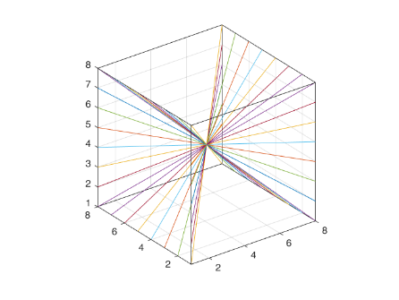
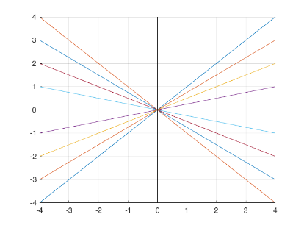
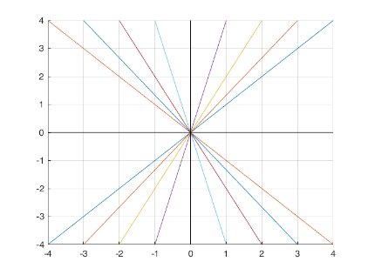
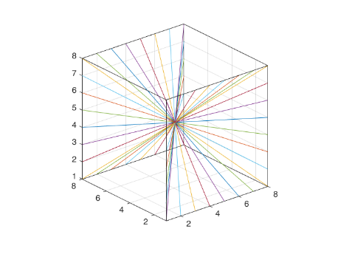
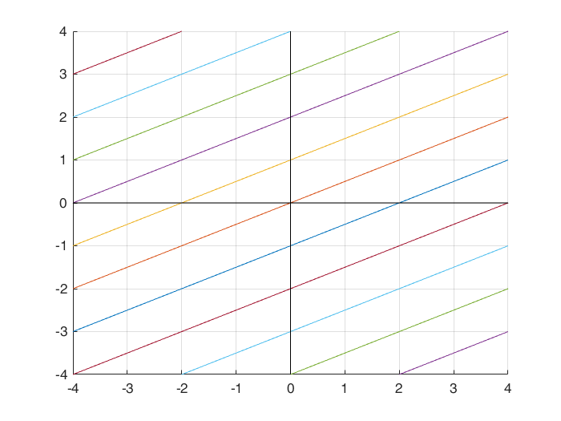
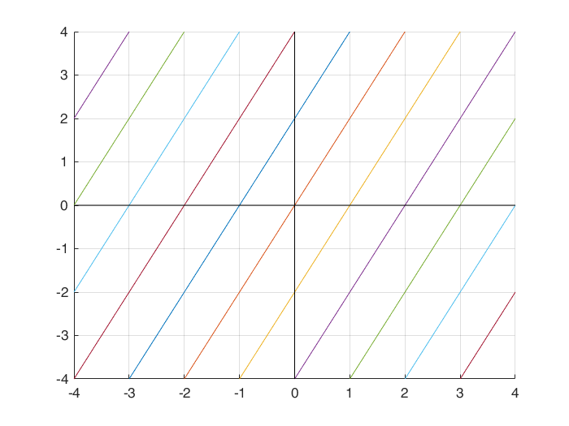
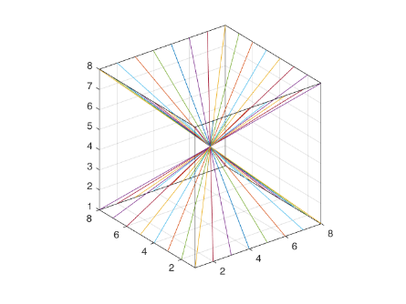
Background
Discrete Parameterization of Line Segments
Slope-Intercept System
Fixed intercept, varying slope
X-driven
X-driven
Y-driven
Y-driven
Fixed slope, varying intercept
Z-driven
X-driven
Y-driven
Notes:
Another aspect is choosing expressive set and parameterization of line segments for line integration

Slide 11
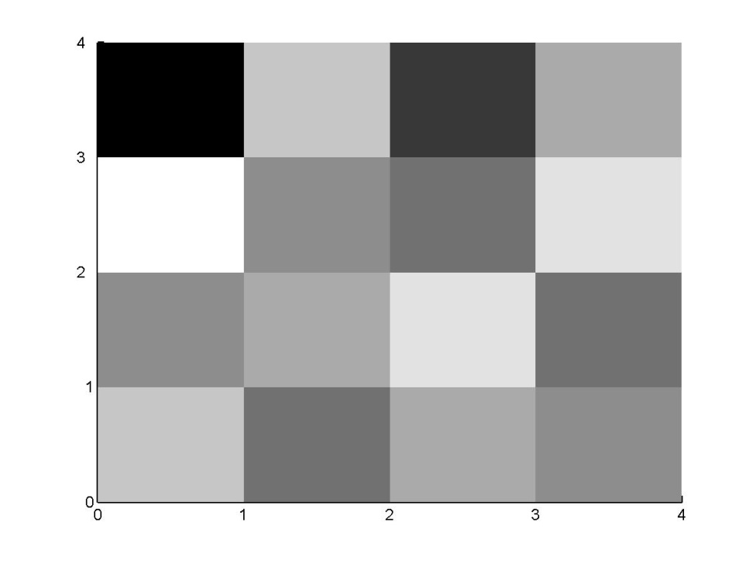
(Background) Computation of the Discrete X-ray Transform. Direct Evaluation Methods
0
9
1
9
10
5
3
10
6
8
10
3
9
3
8
4
Notes:
The most simple straightforward way for transform calculation
Weighted sum
Easy to understand but complicated

Slide 12
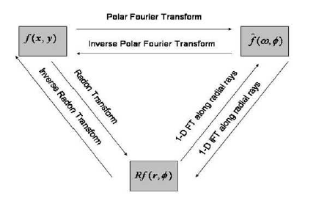
(Background) Computation of the Discrete X-ray Transform. Fourier-Domain Based Methods
Projection-Slice Theorem
Equivalent to computing integrals over trigonometric interpolation of the sampled image. Tied to slope-intercept system.
Computational Complexity – O(log(N)) per coefficient
Fast Slant Stack (2003), Averbuch et. al.
Notes:
The most simple straightforward way for transform calculation
Weighted sum
Easy to understand but complicated

Slide 13
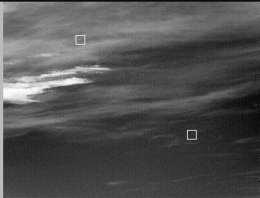
Background
Dim Target Detection
Infrared Images
Point Target
Noise, Background
Presumptions on Target Motion
In Space-Time Coordinates target trace can be seen as filament
Y
T
Notes:
Scientific area that deals with…..

Slide 14
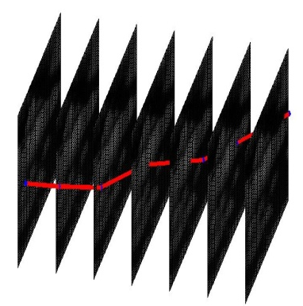
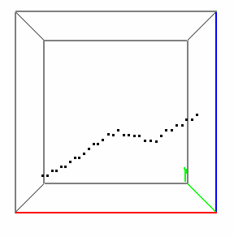
Multiframe Dim Target Detection (MFD)
Detection of man-made dim moving targets by imaging sensors and the estimation of their trajectories
A point target, which can affect up to four pixels in each frame
Low SNR (barely seen by naked eye)
A moving target leaves a signature in the 3D image
Acceleration does not exceed half a picture element per frame. Different kinds of background noise are considered.

Slide 15
(SHAS) Motivation: Desired X-Ray Transform Algorithm Performance Measures
Accuracy (with respect to Direct Evaluation and piecewise constant interpolation of digital image)
Speed
Memory access (Sequential/non-sequential )
Flexibility of line sets definition
Notes:
Our opinion about transform algorithm quality based on several measures

Slide 16
(Algorithm) SHAS Algorithm Properties
SHAS algorithm (“SHift And Sum”)
Exact
Fast
Memory-wise economical (Serial Access, “In-Place” calculations)
Flexible with respect to the choice if lines set (Suited for any equispaced lines family)
Easy for Implementation
Easy for Parallel Implementation
Notes:
The name of proposed algorithm is abbreviation of …
The qualities are …

Slide 17
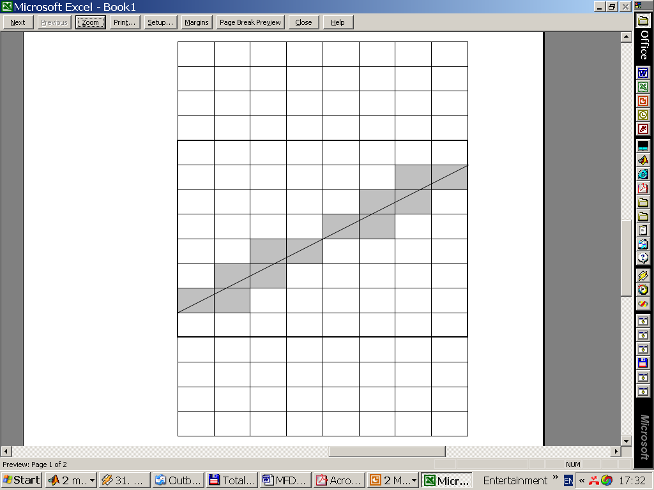
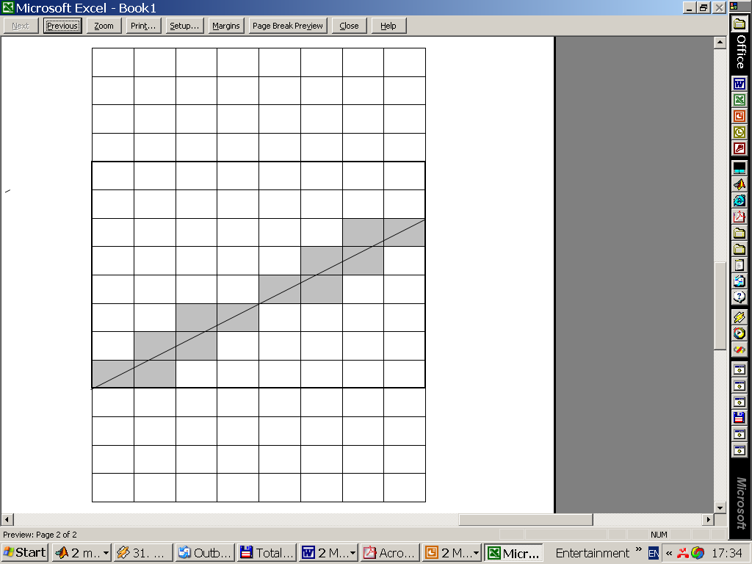
(Algorithm) Observation
Notes:
I’ll start by demonstrating the main ideas in 2D …
The distribution of weights for line integral is similar for parallel line segments up to appropriate shifts

Slide 18
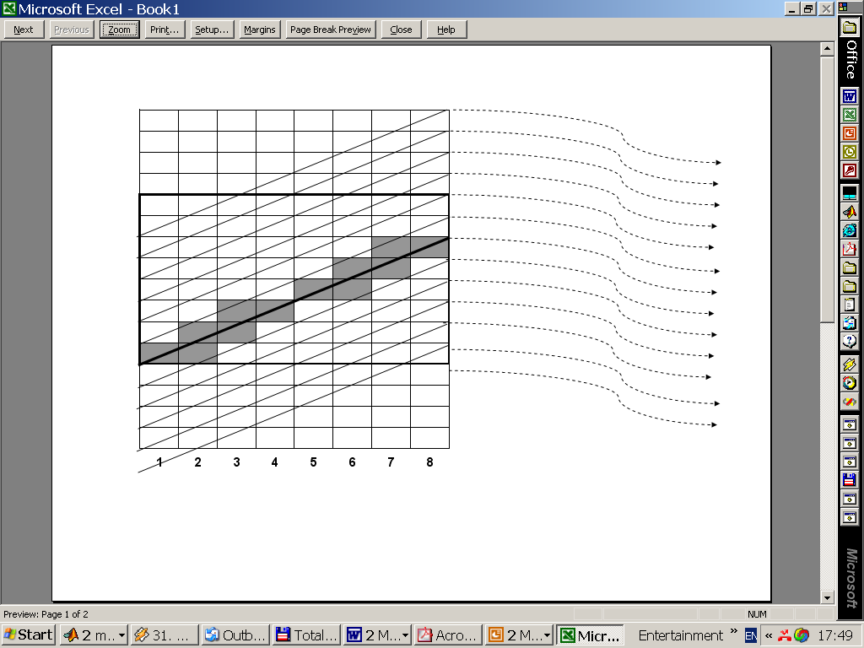
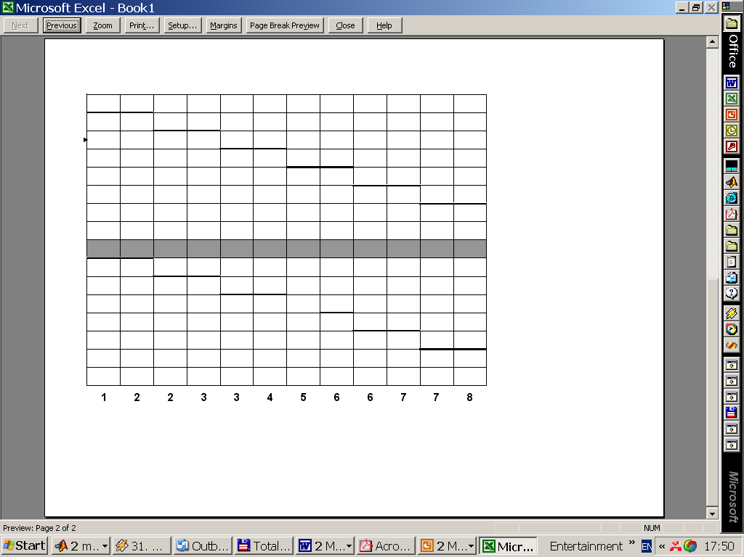
(Algorithm) Simultaneous calculation with serial memory access
Notes:
Note that weighted sum of all columns results in array of X-ray coefficients corresponding to parallel set of lines

Slide 19
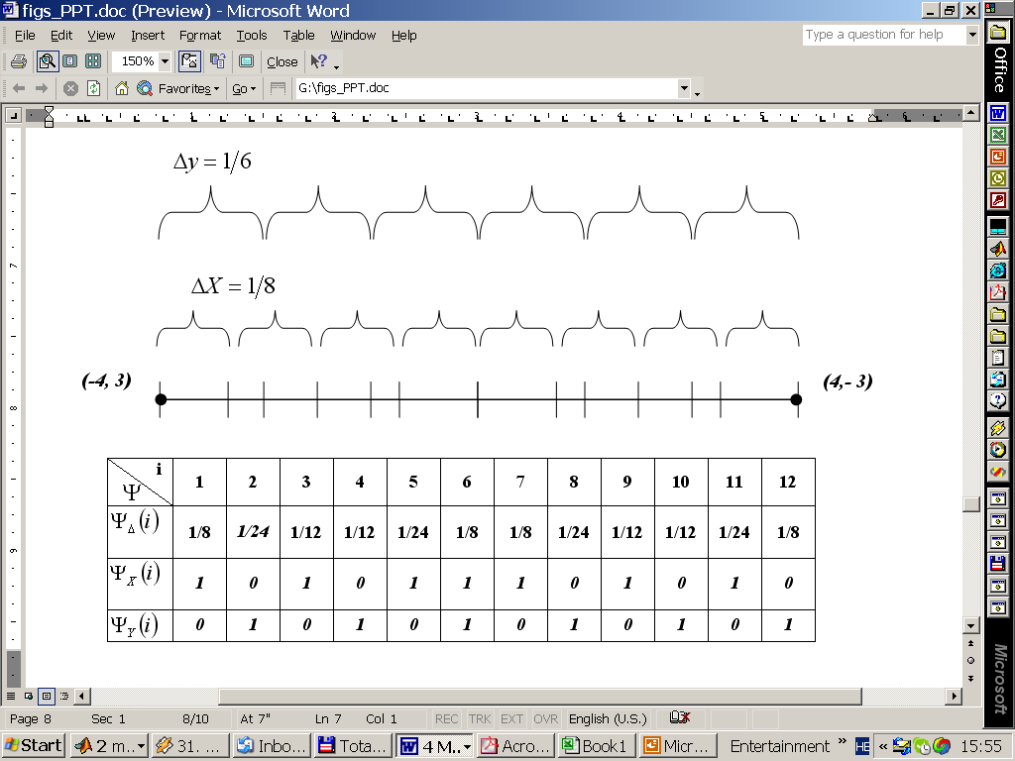
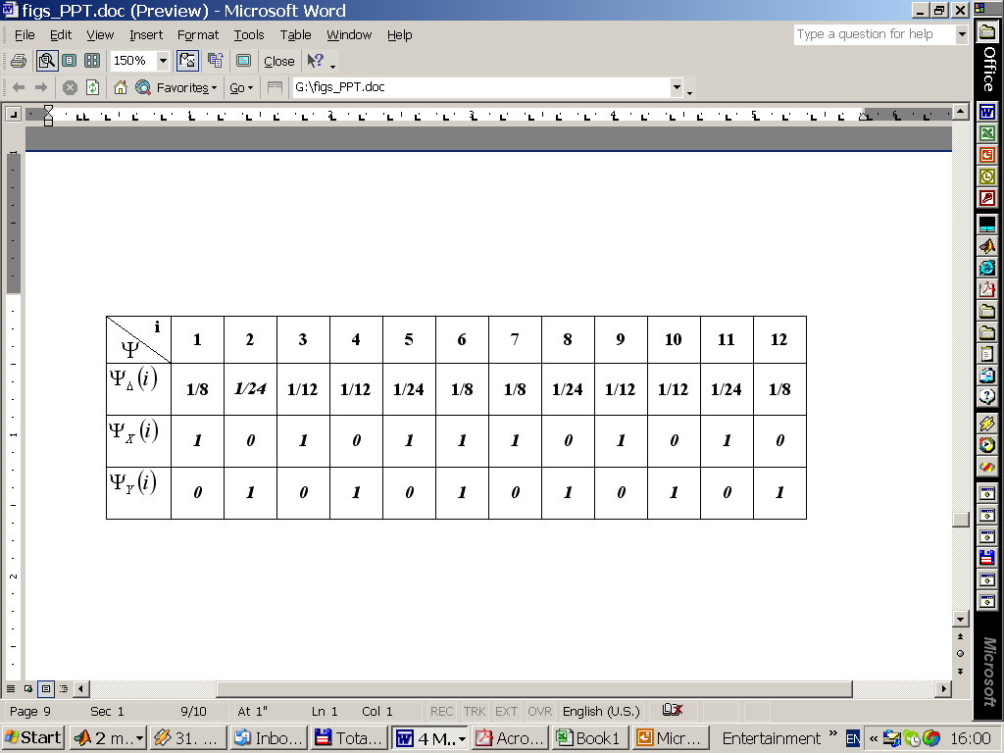
(Algorithm) Merging Series of Grid Intersections 2D
-8 -7 -6 -5 -4 -3 -2 -1 0 1 2 3 4 5 6 7 8
(-4,3)
(-3,3)
(-3,2)
(-2,2)
(-2,1)
. . .
-4 -3 -2 -1 0 1 2 3 4
Notes:
So this is the idea , now I will explain algorithm formally
First we calculate intersections of line segments with grid planes, we analyze intersections of line with zero intercept …
So we will know for each column if to make shift and weight to multiply

Slide 20
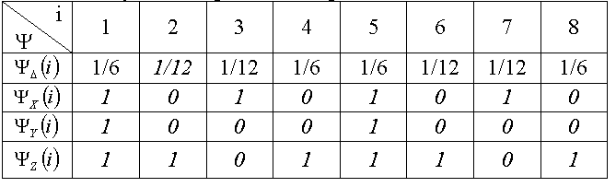
(Algorithm) Merging Series of Grid Intersections 3D
(-2,1,-3)
(2,-1, 3)
Notes:
The same idea in 3D

Slide 21
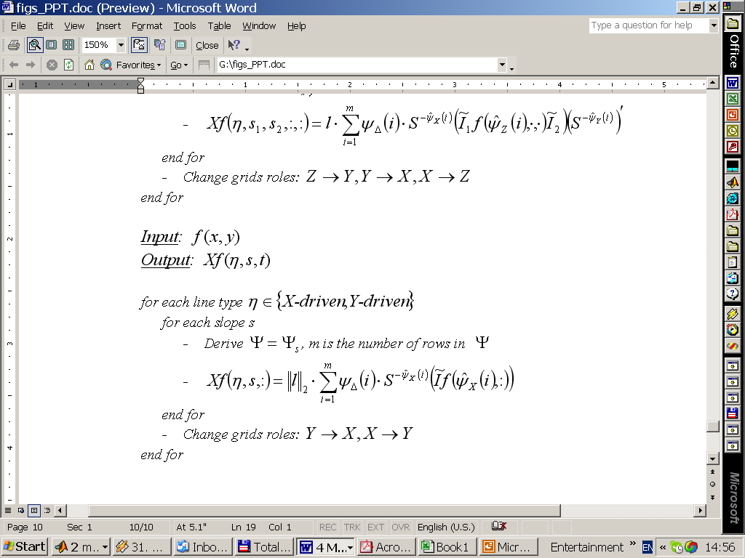
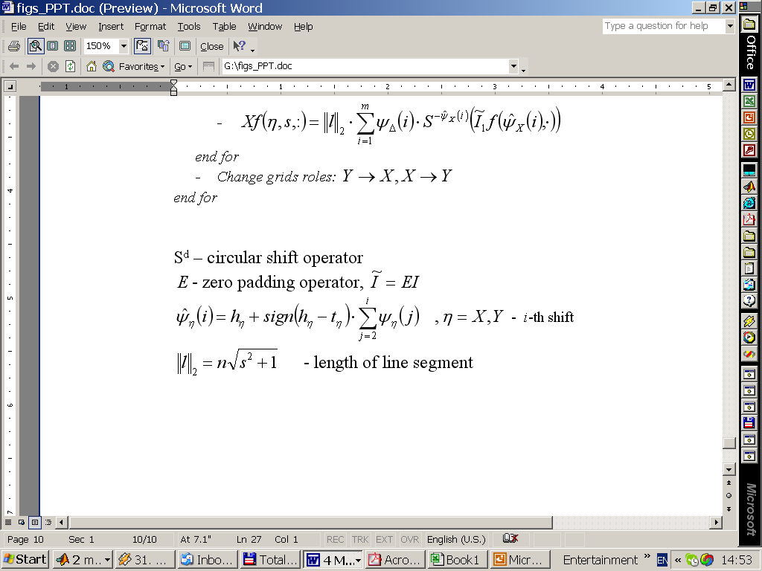
(Algorithm) SHAS Algorithm Pseudocode 2D
Notes:
The algebraic form of algorithm
Where …

Slide 22
(Performance) Speed
Pentium 4, 2.4GHz, 512Mb
C++ implementation of 3D transform
SHAS algorithm is faster for moderate sizes of input arrays
For Example:
Cube Side: 128
# Coefficients: 3.22E+09
Total Time: 5664 sec (~1.5 hour)
Per Coefficient: 1.76E-06 sec
Notes:
Theoretically O(log n) against O(n) , but in fact algorithm is comparative with FSS up to very high practical data cubes.
Due to serial access, simplicity.
Pentium III , 1Gb speed , 512 Mb RAM, 512 KB CASH

Slide 23
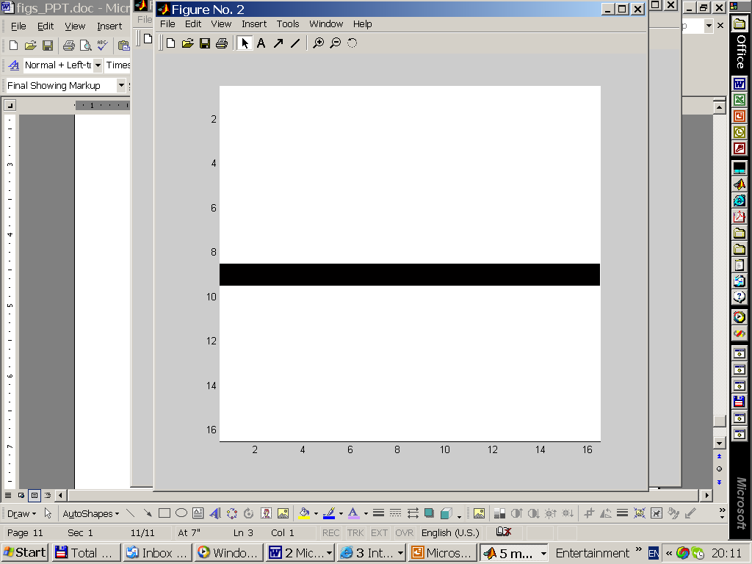
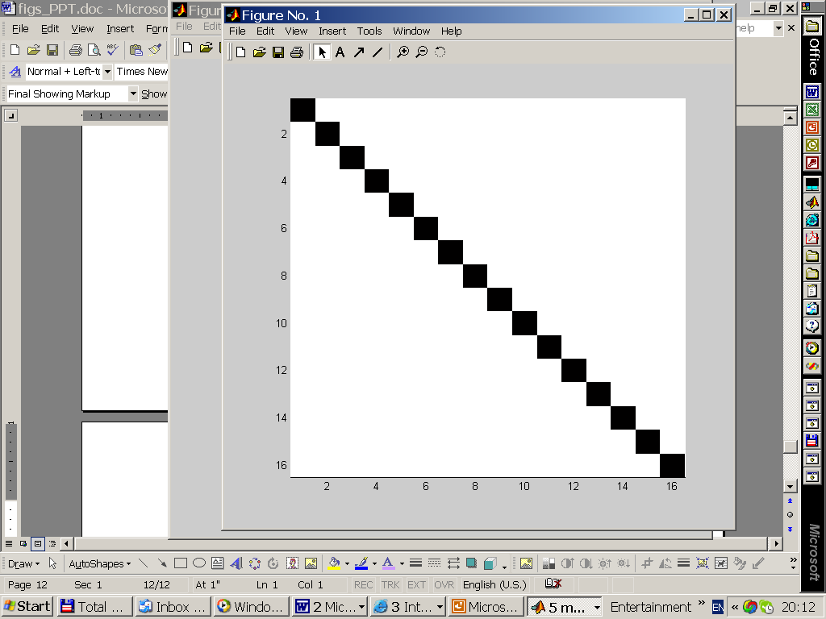
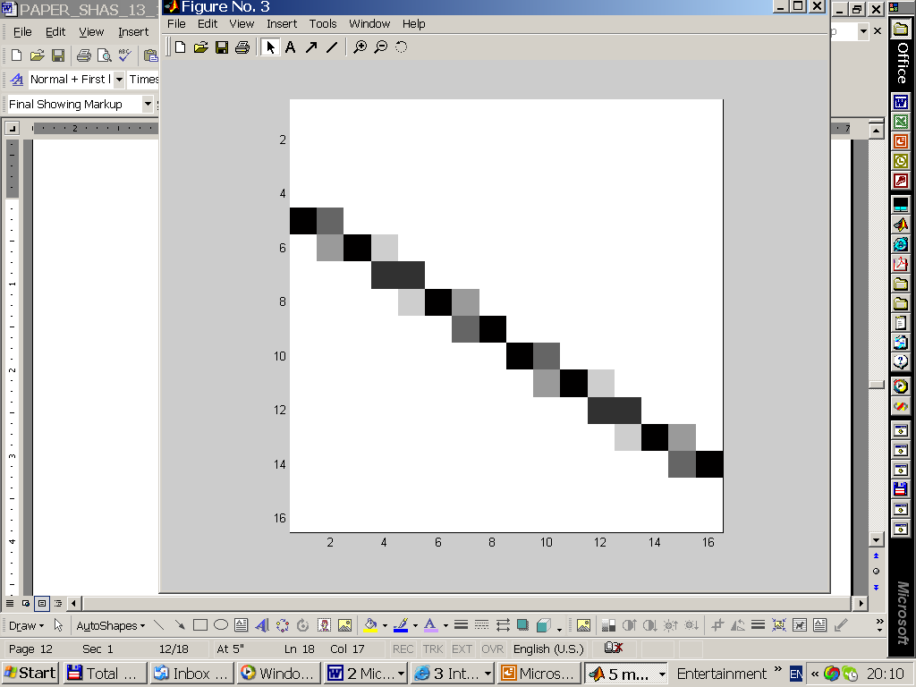
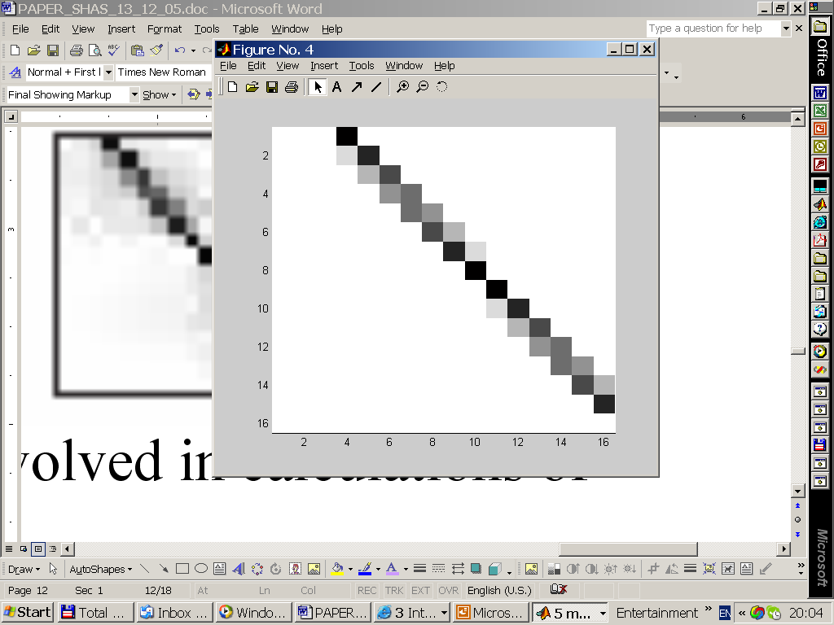
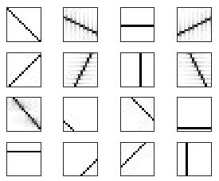
(Performance) Accuracy
Back Projection Of Various Coefficients
SHAS
Slant Stack

Slide 24
Dynamic SHAS Algorithm (DSHAS) Sliding Window Approach
Dynamic Region of Interest (RIO)
Real-Time Computations
Support: Axis-Parallel Window Transition (left/right/up/down/in/out)
Support: Shrink / Enlarge Window (limited)

Slide 25
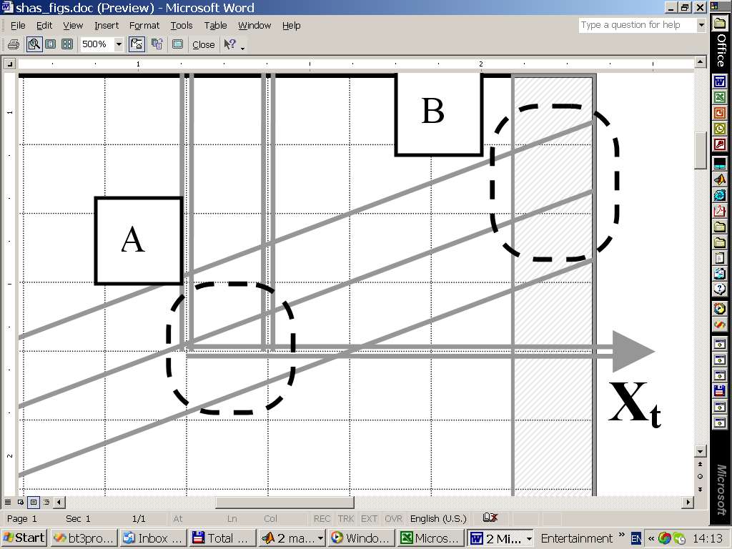
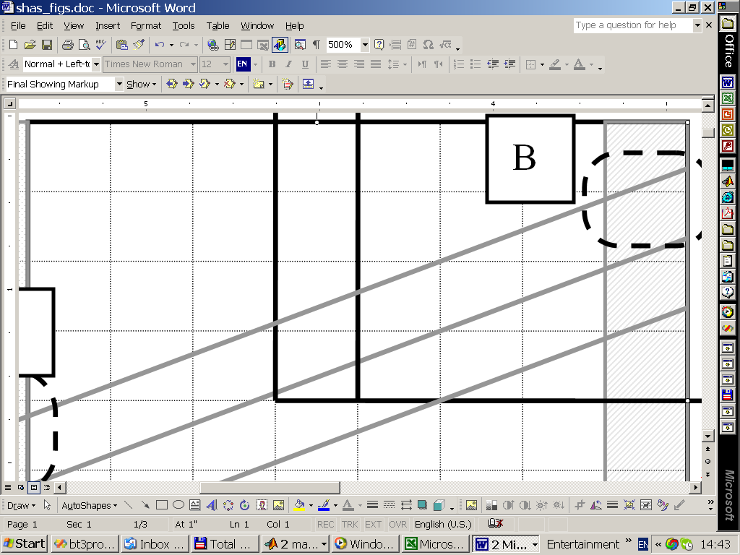

DSHAS
Y_{t}
Y_{t+1}
X-Driven Update
v^{out}
v^{in}
A
B
B
Y_{t}
Y_{t+1}
X_{t}
A
w₁
1-w₁
Y-Driven Update

Slide 26

DSHAS: Why Sliding Window ?
Constraints on memory and speed (moderate cube 64³ => 1.5 Gb of coefficients)
Shift-invariant
Dynamic Region of Interest
Fast

Slide 27




Dynamic SHAS Algorithm (DSHAS)
2D Application
3D Application (Related to MFD)
Natural Extension of SHAS algorithm
Optimal run-time (O(1) per coefficient)
Exact

Slide 28
Background
The 3D X-Ray Transform
As
Notes:
Scientific area that deals with…..

Slide 29
Background
Bcvbcbv
Bcvbcv
Bcvbcb
Bcvcbvc
cbvbcb

